Slide 1
How to do video conferencing.

Slide 2
Slide
Three
Before the meeting.
Introduction
Seven
Starting the meeting.
In this presentation, I list the best practices of video conferencing so that your digital meetings become just as successful as their analogue brothers.
Feel free to re-use this presentation with your own branding to educate your colleagues!
Eleven
During the meeting.
Sixteen
Ending the meeting.
Nineteen
After the meeting.
Twenty
Summary

Slide 3
Before the meeting.

Slide 4
Before the meeting
Become familiar with the software Whether you're using Skype, Zoom, Google Hangouts or any of the other video conferencing software, you should become familiar with the functions that will help you streamline your virtual meetings. Each service can have different features like polling, whiteboards or hand raising - and more importantly, the option to mute someone when they are producing a lot of background noise.
Fix technical difficulties beforehand Nothing is more bothering than dropped calls, constantly freezing video or audio and having to wait for others trying to figure out why their microphone is not working. Especially when you have an external meeting, this will make a bad impression. Take the 10 minutes to check if everything is working fine before you have an important meeting.

Slide 5
Before the meeting
Establish who is participating Before the meeting, you should establish who should be participating in the video conference. This is because a meeting with two colleagues requires a different amount of effort than a meeting with a group of clients. It is also smart to keep the number of participants to a minimum, as the ones that are not actively involved can get more easily distracted during a call than during an in-person meeting.
Send clear call instructions Make sure you send detailed and clear instructions on how to join the meeting at least an hour in advance. With the earlier mentioned tools, this can be as easy as sending a link to the participants. But as conferencing etiquette, it is also common courtesy to let the participants know who will be in the call, if necessary, what their roles are, the time and date and the expected duration of the meeting.

Slide 6
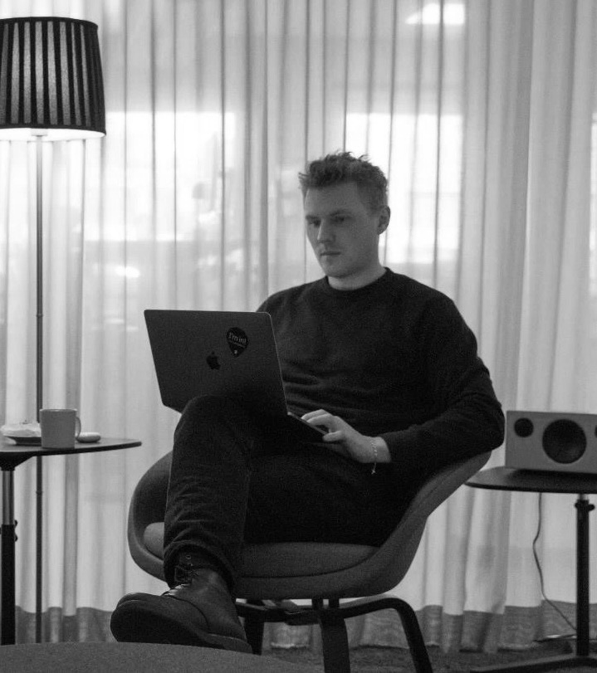
Before the meeting
Organise and prepare The next step of preparation focuses on the actual content of the meeting. It is important to know when to discuss what and roughly how long it should take. You can do this by preparing an agenda or outline for both yourself and the other participants. Also, prepare other materials to support the call to keep things on track and reduce the potential for wasting time on unimportant topics.
Be aware of your location
Unlike an analogue meeting, you can be taking the call anywhere, and anything could be going on around you. Therefore, it’s essential to be aware of your surroundings as it can cause distraction and make you miss vital information. It could also distract or make it very difficult for others to hear what you are saying if there is background noise. Especially when video calling from home, it is important to be aware of your background and making sure there is nothing that you'd rather not show to cause disturbance for the participants in the meetings.

Slide 7
Starting the meeting.

Slide 8
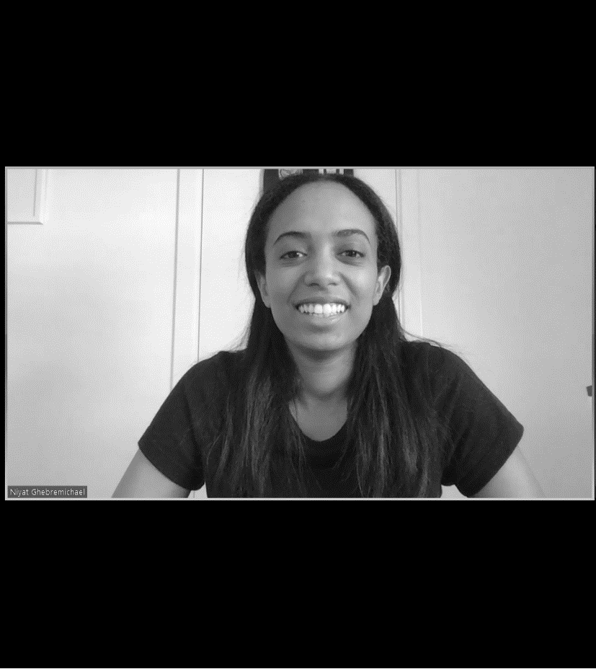
Starting the meeting
Be punctual This should be without saying. But it is extra important to be punctual during a digital meeting. When you are a few minutes early, you have time to solve any last-minute technical difficulties and to prepare yourself. Start the meeting on time, and if someone joins late, do not start over again. To keep the process smooth, ask someone else to inform the latecomer about missed details after the meeting.
Make it a habit to use video Not just for yourself but also the other participants. This will add extra depth to the conversations as it creates more engagement and interaction and adds visual cues such as body language and facial expressions. Video also forces participants to be more attentive, as it will immediately be clear when they are not focused on the meeting.

Slide 9
Starting the meeting
Always introduce yourself Besides common courtesy, it is always good to introduce yourself. If you're late, wait until there is a chance to introduce yourself. This is especially important during conferencing with people you have never met before so that they can hear your voice and recognise when you're speaking later. For this reason, it is also important to at least say ’hi’ if someone else introduces you.
Be upfront about call disruptions Ideally, you would be inside a quiet area when having a digital meeting. Though realistically this is sometimes not the case and you have to deal with noisy surroundings. In this case, it is important to be upfront and inform the other participants of the situation. If you do not acknowledge the noise in the background, the other participants may assume that there is a bad connection or feel like you're not taking the call seriously. By being upfront, you avoid this situation and move the meeting forward.

Slide 10
Starting the meeting
Break the ice While waiting for everyone to connect, take a moment to share a quick story about the weekend or ask a question that will start a conversation. This will avoid a silence where people might wonder if the connection is working, it breaks the ice and people get into the mood of listening to one another. Wrap up the small talk as soon as the key people have joined and then start with the purpose of the call.

Slide 11
During the meeting.

Slide 12
During the meeting
Speak loudly and clearly Especially with conferencing, it is very important to speak loudly and clearly, as there are a variety of reasons why it may be more difficult for others to hear what you're saying, as compared to a normal meeting. This becomes even more important if it is an audio-only call.
Encourage participation A quick and easy way to keep everyone engaged is by asking questions. One of the biggest challenges you will run into with conferencing is that people can easily start daydreaming when they are not actively involved. Add to this the inclination of people to stay quiet and many of your questions might go unanswered. Consequently, it is important to do your best to engage the other participants by asking for distinct feedback specifically directed at someone.

Slide 13
During the meeting
The agenda Everyone is busy, and you do not want to waste their time. That is why it is important to have an agenda and stick to it. When meetings are concise and on point, people are more willing to participate and stay engaged. When you follow an agenda you also limit the risk of having the meeting extended, which would likely reduce participation and attentiveness. Within the agenda it is recommended to schedule a few minutes in the end to discuss questions or comments that are brought up during the meeting.
Use visual aids Visual aids are a great way to switch up how people are taking in information and help to keep the other participants engaged. They work very well to present new ideas or plans for a large group. Just make sure they are short and do not provide too much information.

Slide 14
During the meeting
Avoid unnecessary silence When you are talking to someone in person a brief silence is not a problem, as the other person can see why you might not be responding. But in a digital meeting, it can be very confusing, especially if there is no video connection. People might assume that there are technical difficulties or that the other person is distracted. In this case, it is best that when a situation arises where a direct response is not possible, to describe the steps that are being taken or by saying something like: "let me think about that for a second.”
Keep the meeting short As touched upon earlier, you need to do what you can to keep people engaged and involved. One sure-fire way to lose that is by having meetings that take much longer than needed. Besides using an agenda you can keep the meetings short by only involving the people that are necessary for the meeting's objective. This way, you reduce the chance of unimportant discussions. If a discussion comes up that focusses around two people and is of little significance for the others, you can ask it to be followed up after the meeting.

Slide 15
During the meeting
Mute your microphone when quiet This suggestion is a bit of a double-edged sword and requires some nuance. Conferencing etiquette suggests that everyone mutes their microphone when they are not speaking so that background noises do not interrupt the meeting. However, being muted also reduces the possibility of spontaneous interactions. That is why I would recommend to mute the microphone in meetings with many participants but keep it unmuted in calls with around 5 participants or less.
Record the meeting If you make recording digital meetings a habit, it could be effective to keep track of meetings and having the ability to verify what was discussed at any time. It is also an easy way for people that have missed the call to know what was discussed. If this is less relevant for you, you could consider only recording digital meetings when something specifically important is being discussed.

Slide 16
Ending the meeting.

Slide 17
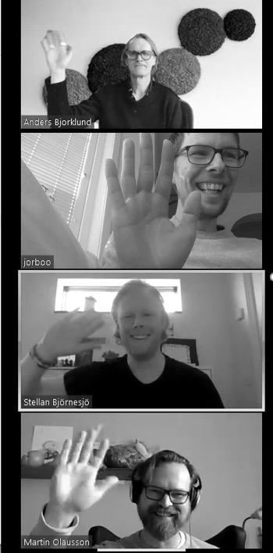
Ending the meeting
Establish what was accomplished When the meeting is ending it is wise to quickly touch upon the next steps, responsibilities and deadlines and confirm that everyone is on the same page and is aware of what is expected from them. This way you reduce the chance that someone has missed some vital information and ensure a smooth continuation.
Leave with a goodbye Just like you would leave a regular meeting you should leave a digital meeting with a formal goodbye. Even if you did not say much it is good to make your presence felt and potentially schedule a follow-up. A rule of thumb is to silently count to 5 before closing the call, to make sure you do not miss any final comments.

Slide 18
After the meeting.

Slide 19
After the meeting
Schedule a follow up (if needed)
Usually there is a need to follow up on the details that have been discussed during the meeting. Perhaps certain members have to look up information before a consensus can be reached. In this case it is essential to schedule a follow up early in order to keep the momentum going.
Share the recording
If the meeting was recorded because it was important to have access to the details at a later date or because somebody was late it is best to share the recording immediately after the meeting and only with the relevant people. When you don't make this a habit it become very easy to forget about it.

Slide 20
Summary
Starting the meeting.
Before the meeting.
During the meeting.
Be punctual.
Make it a habit to use video.
Always introduce yourself.
Be upfront about call disruptions.
Become familiar with the software.
Fix technical difficulties beforehand.
Establish who is participating and send clear call instructions.
Organise, prepare and be aware of your location.
Speak loudly and clearly and encourage participation.
Use an agenda and visual aids.
Avoid unnecessary silence and keep the meeting short.
Mute your microphone when you’re not speaking.
Record your calls.
Ending the call.
After the meeting.
Establish what was accomplished.
Leave with a goodbye.
Schedule a follow up.
Share the recording.

Slide 21
Thanks for reading!
When you and your colleagues keep these best practices in mind your next conference call will be smooth as butter.
Would you like help with a specific step? Press the button below and I’ll be glad to help!
View this presentation in full screen mode, to be able to click on the button above.
Author
Jorik Boot
Jorik is Zooma’s resident Dutchman. With an analytical mindset and a creative spirit, he loves to discuss strategy, dive into data and get involved in media.
jorik.boot@zooma.se

